Slide 1
UTC as a time reference for industry Elizabeth Laier English Peter Whibberley Conway Langham David Hicks Simon Ashford Ali Ashkhasi Marivon Corbel

Slide 2
Outline
A brief history of the national time scale
Atomic timekeeping and redefinition of the second
International Time today: UTC
The UK’s national time scale UTC(NPL)

Slide 3
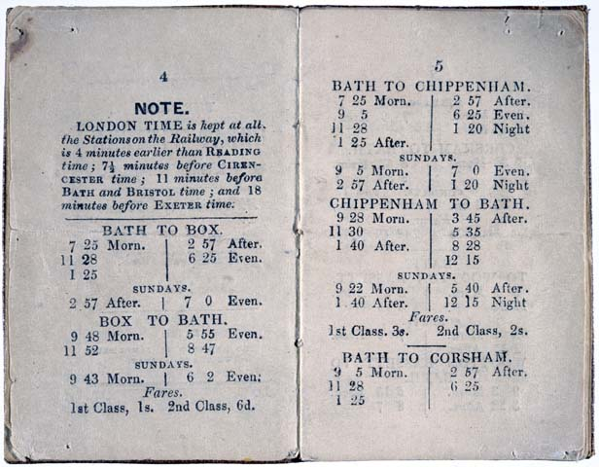
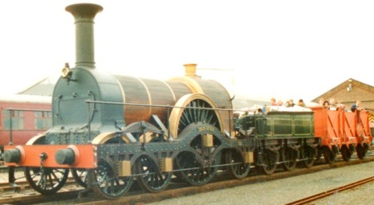
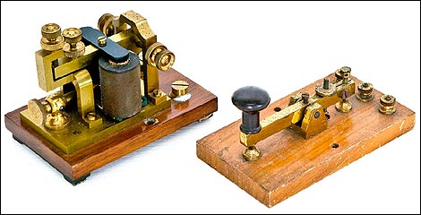
A brief history of the national time scale
Railways drove the standardization of time across the UK in the 19th century
The electric telegraph provided the means to disseminate time from Greenwich from 1852

Slide 4
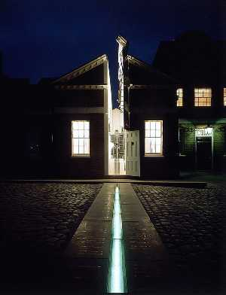
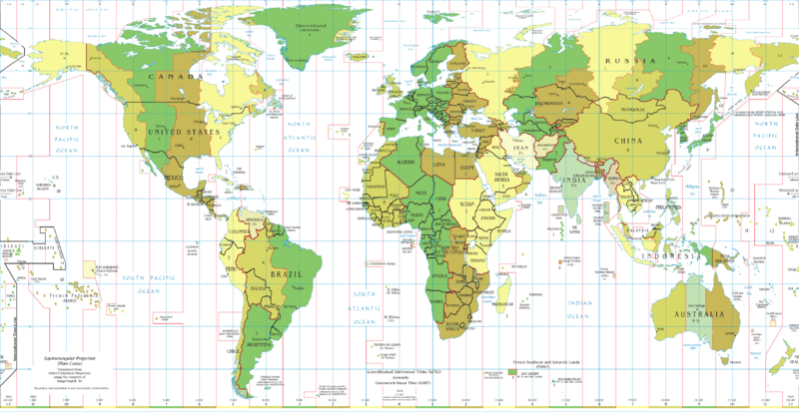
1884: International time
The International Meridian Conference in Washington DC:
Adopted Greenwich as the prime meridian
Recommended GMT as the reference time for the world
Proposed the time zones system
1 second = 1/86400 of the mean solar day
-

Slide 5
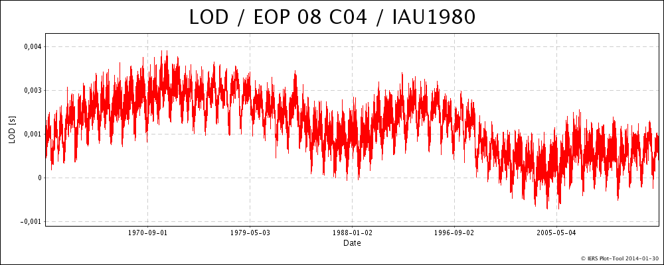
1950s: Variations seen in Earth’s rotation
3 ms
0 ms
Plot shows length of day in excess of 86400 SI seconds (LOD),
1962-2014 (Source: IERS)

Slide 6
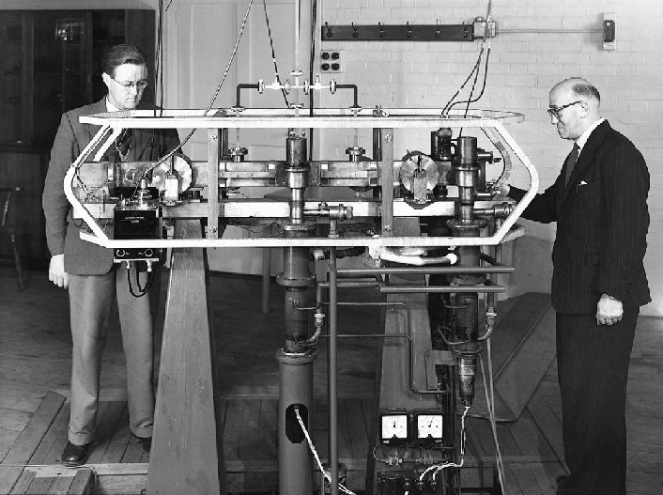
Start of atomic timekeeping
1955: Louis Essen and Jack Parry with the NPL Cs frequency standard, Accurate to 1 part in 1010 or 1s in 300 years
1958: International Atomic Time (TAI) Formed following the development of further caesium clocks in the USA and Switzerland
1960: Coordinated Universal Time (UTC) Introduced as the reference time scale for time broadcasts

Slide 7
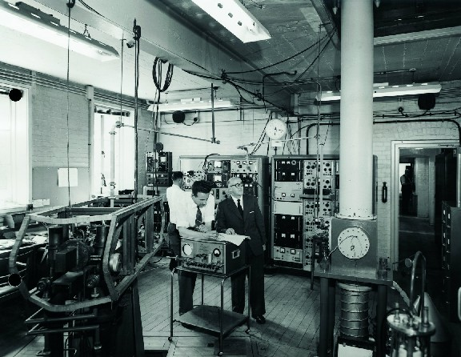
1960s: NPL caesium standards

Slide 8
1967: Redefinition of the second
A new definition adopted for the second in the International System of units of measurement (SI):
The second is the duration of 9 192 631 770 periods of the radiation corresponding to the transition between the two hyperfine levels of the ground state of the caesium-133 atom.
Atomic time: Definition of the second is now based on an electron frequency transition of the caesium atom

Slide 9
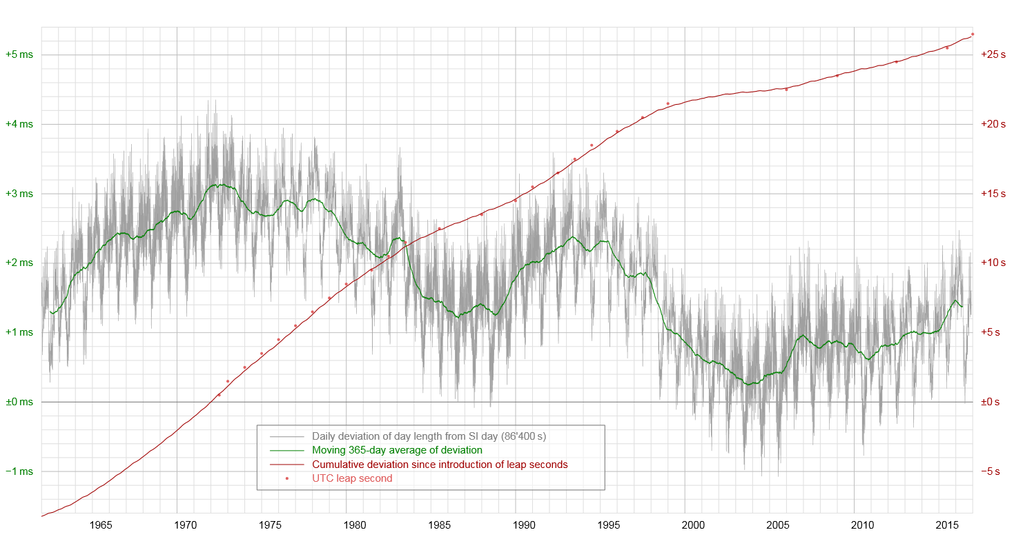
Leap second insertions
27 leap seconds since 1972,
all positive

Slide 10
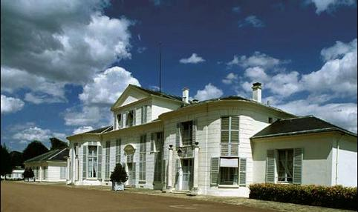
International Time Today - UTC
Computed by the International Bureau of Weights and Measures
(BIPM – Bureau International des Poids et Mesures)
Based at Sèvres, Paris

Slide 11
Summary of how UTC is formed
Stability and resilience is achieved by averaging around 500 atomic clocks in around 70 institutes worldwide
Accuracy is achieved using data from Cs fountain primary standards
The results are published monthly in BIPM Circular T and weekly ‘rapid’ results published in UTCr
The IERS decides on leap second insertions to keep UTC in step with the Earth’s rotation (UT1)

Slide 12
Generation of UTC
~70 National
Timing Institutes
BIPM
Local UTC(k)
time scales
Free Atomic Time
(EAL)
IERS
Earth rotation
measurements
International Atomic Time
(TAI)
~500 commercial
atomic clocks
leap seconds
Universal Time
(UT1)
Primary
Frequency
Standards
(PFS)
Coordinated Universal Time
(UTC)
corrections to local
UTC time scales
BIPM Circular T

Slide 13
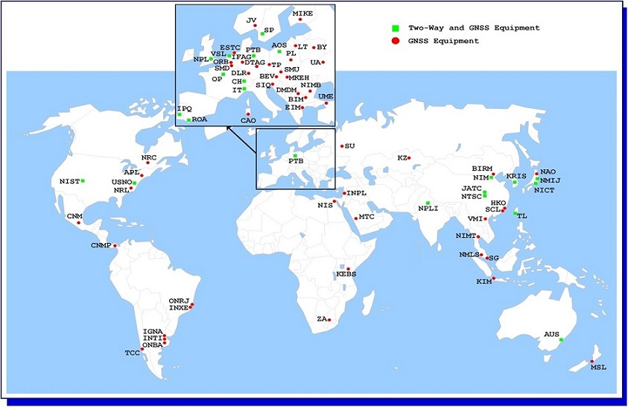
Institutes contributing to UTC
Source:
BIPM

Slide 14
Properties of UTC
Not available in real time
Accessed via one of the approx. 70 UTC(k) institutes, eg. UTC(NPL)
Provides the reference for ALL civil and broadcast time scales, eg:
GPS time (and other GNSS)
Internet time (NTP)
Radio time signals

Slide 15
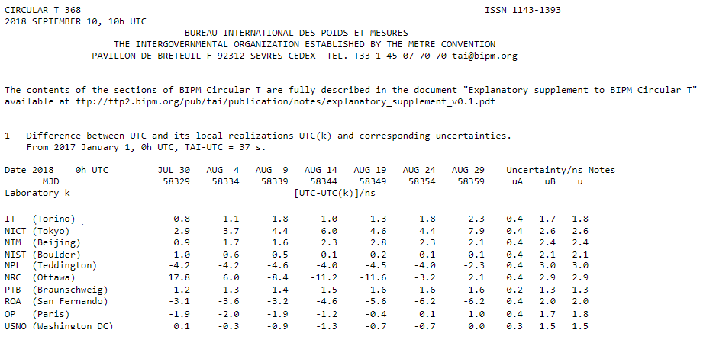
BIPM Circular T
Published monthly and gives UTC-UTC(k) results, for example:

Slide 16
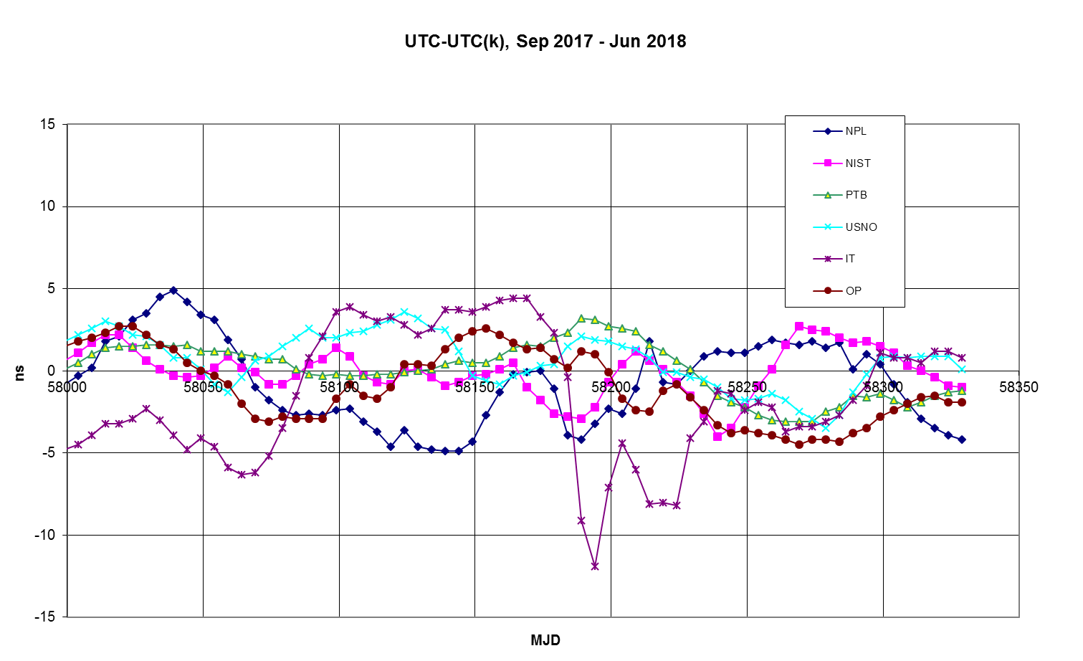
Circular T Results

Slide 17
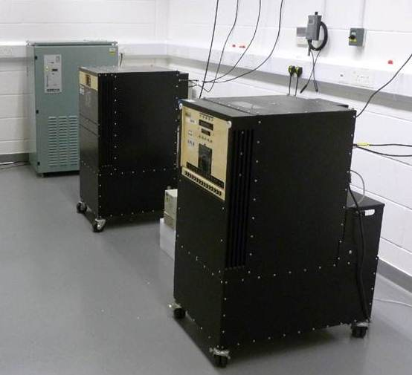
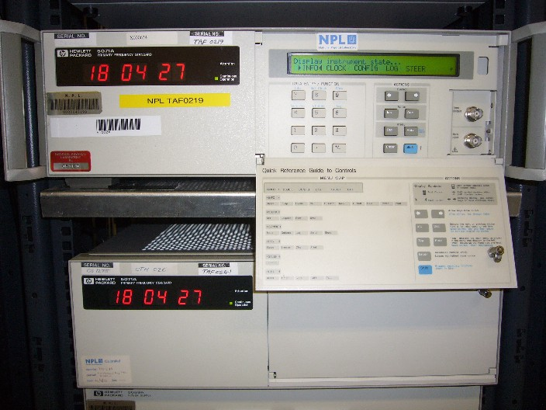
UTC(NPL) time scale
Based on a group of continuously-running commercial atomic clocks:
5 active hydrogen masers and 4 caesium clocks

Slide 18
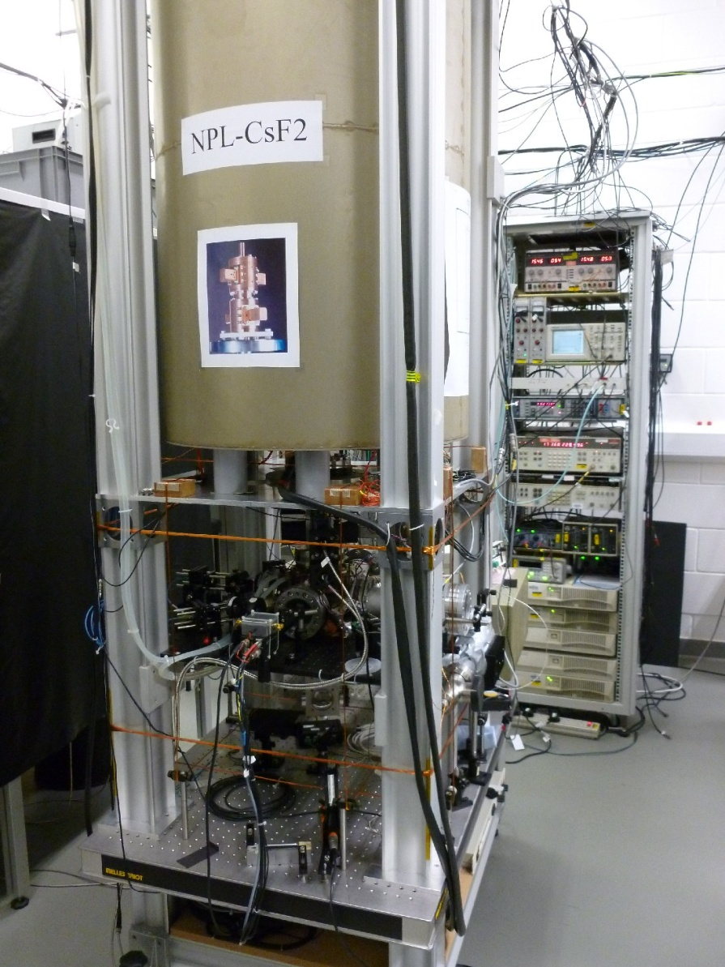
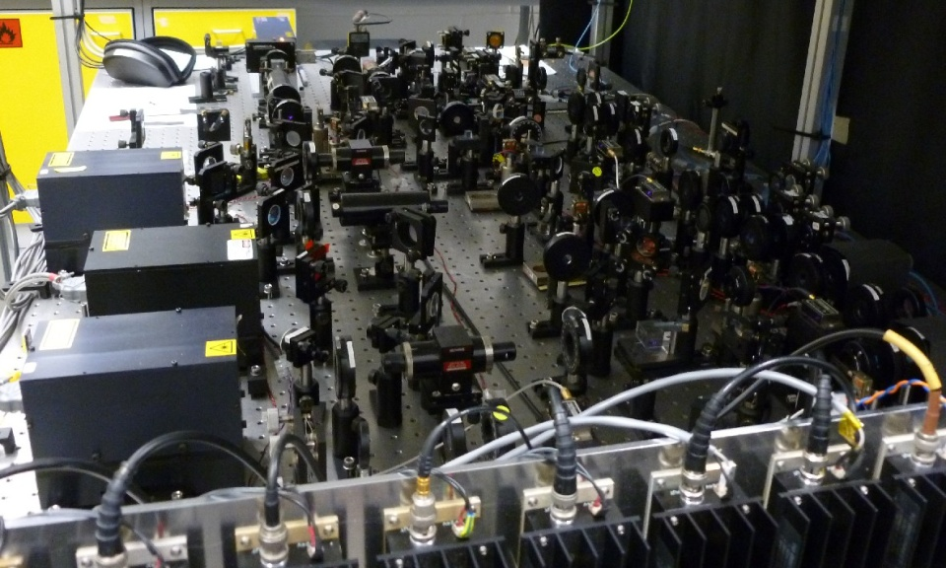
NPL caesium fountains
Two operational fountains: NPL-CsF2
NPL-CsF3
Accuracy is 2.0 x 10⁻¹⁶
20 ps/day
Commercially available from NPL

Slide 19
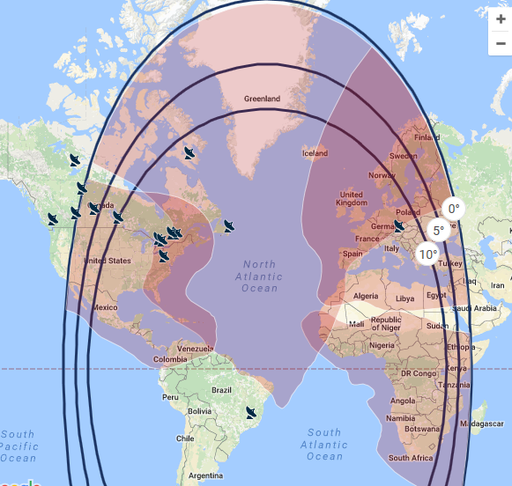
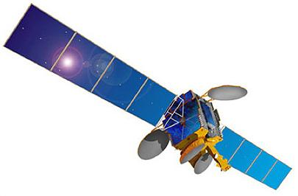
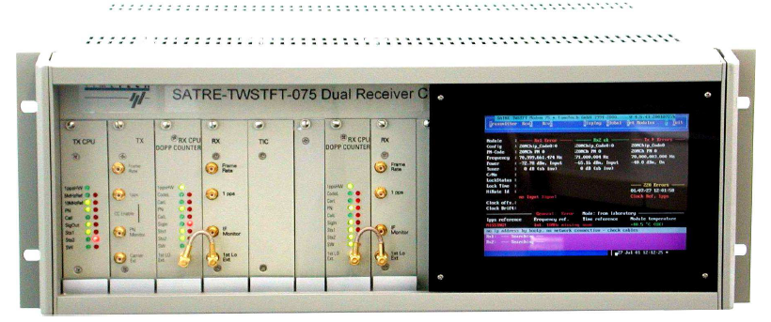
Comparing time scales (1): Two-way satellite time transfer
Geostationary Satellite
Institute 1
Institute 2
Satellite time transfer modems
Modem
UTC(k1)
UTC(k2)

Slide 20
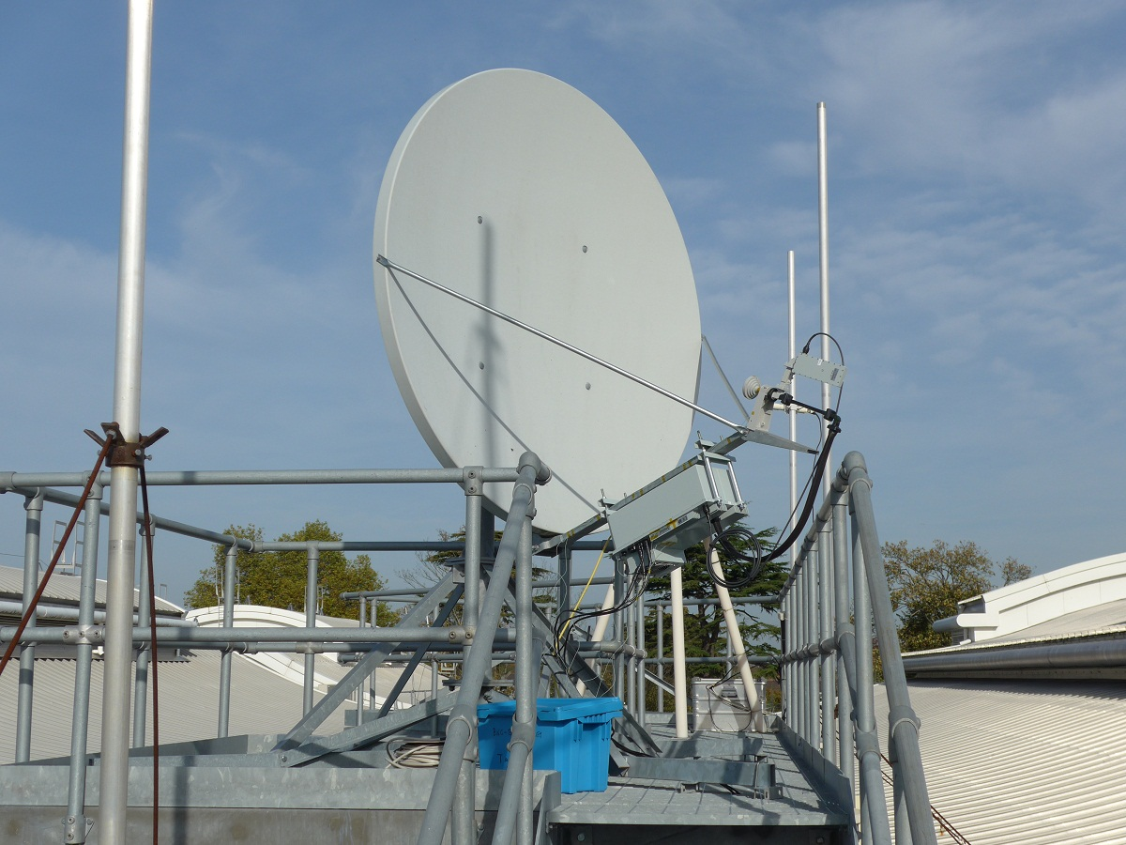
Satellite time transfer earth station
Typical TWSTFT earth station is a Ku-band ‘VSAT’ (Very Small Aperture Terminal)
NPL: Offset parabolic antenna 1.8 m diameter
Signals are modulated with a pseudo-random noise (PRN) sequence containing a time marker
Operation is automated, with sessions every 2 hours
When calibrated, the method is accurate to 1 ns

Slide 21
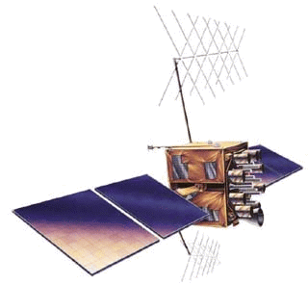
Comparing time scales (2): GPS common-view time transfer
Institute 1
Institute 2
GNSS time transfer receivers
UTC(k1)
UTC(k2)

Slide 22
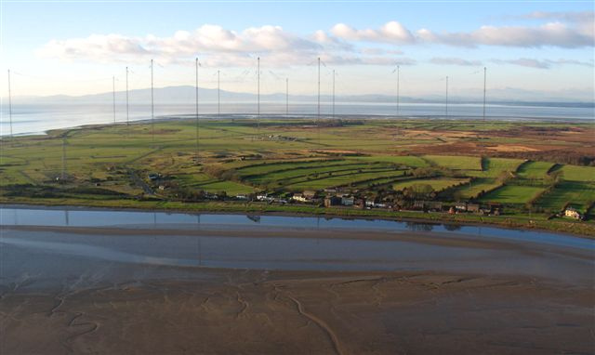
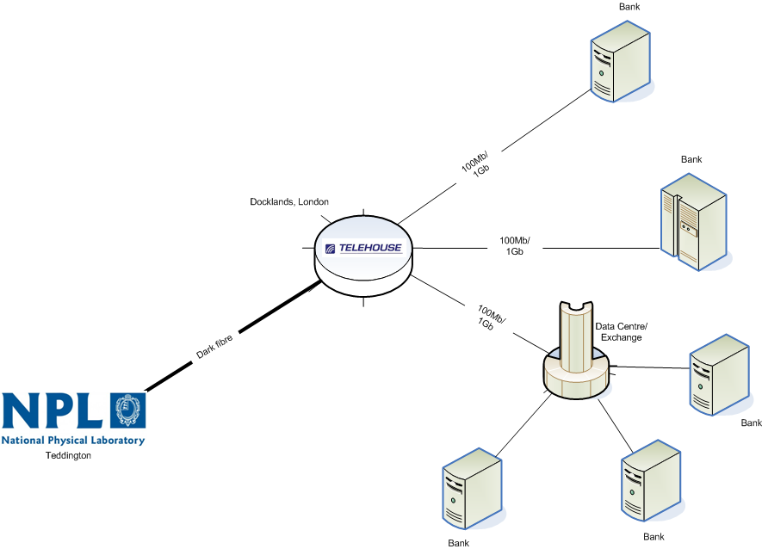
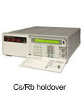
UTC Time dissemination from NPL
NTP internet time service for synchronising computers
MSF 60 kHz radio time signal, broadcast from Anthorn, Cumbria
NPLTime service for UK financial sector using PTP over optical fibre links

Slide 23
NPLTime
NPLTime

Slide 24
CLONETS
Clonets

Slide 25
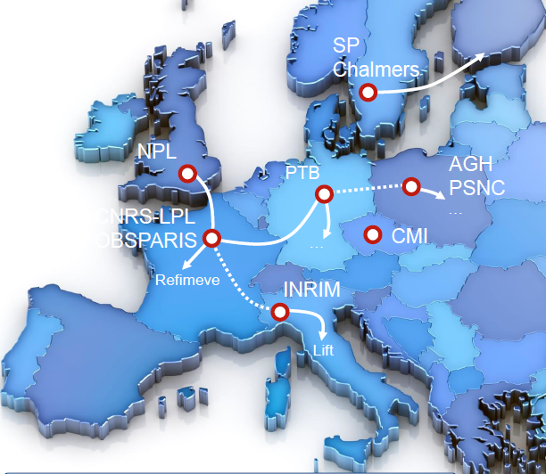
The future of UTC (1)
More and better primary standards
- Optical clocks contributing in the next few years
Improved methods of time & frequency transfer
Regional optical fibre networks
Links using Atomic Clock Ensemble in Space (ACES) from Summer 2020

Slide 26
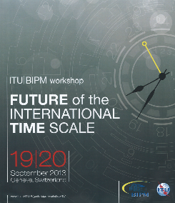
The future of UTC (2)
Ending leap seconds?
Debate over their future since 2000
Will continue until at least 2023
Still no agreement
Clocks on Earth limited by gravity changes
Interest in more and better (optical) clocks in space
Master clocks onboard geostationary satellites?

Slide 30
Summary
UTC is the precise time scale in use world-wide
UTC combines the stability of atomic clocks (SI second) with a close link to mean solar time (UT1)
UTC is accessed through the time scales operated by contributing timing centres, eg. UTC(NPL)

